Slide 1
Sleep Timeline
A tool to watch and monitore Astronauts sleeps

Slide 2
What is ideia?
Basically the idea of ​​this tool is to display in a playful way, data about the sleep health of astronauts
it's just a prototype, made to show the intended concept

Slide 3

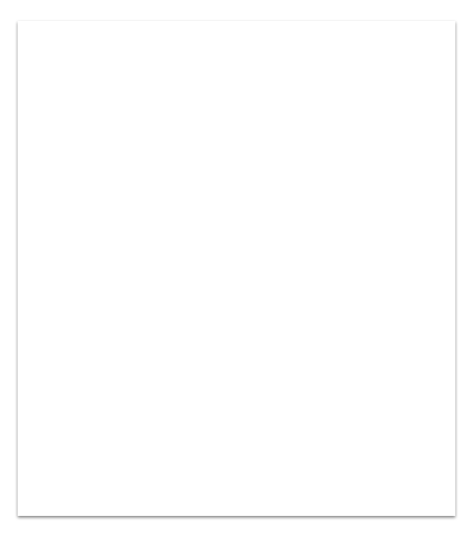
Datasets and Experiments used
To generate data that was feasible, the following experiments and datasets were used
NAG91035 Experiment
9401663 Experiment
J0000975 Dataset
NAG53952 Experiiment
NAG91425 Experiment

Slide 4
What types of metadata are displayed?
The intention is to show some metadata about the following sleep characteristics of astronauts
Sleep Period
Quality of REM
Nutricional Data
Counter Measures to improve sleep
Exercises for the astronauts

Slide 5
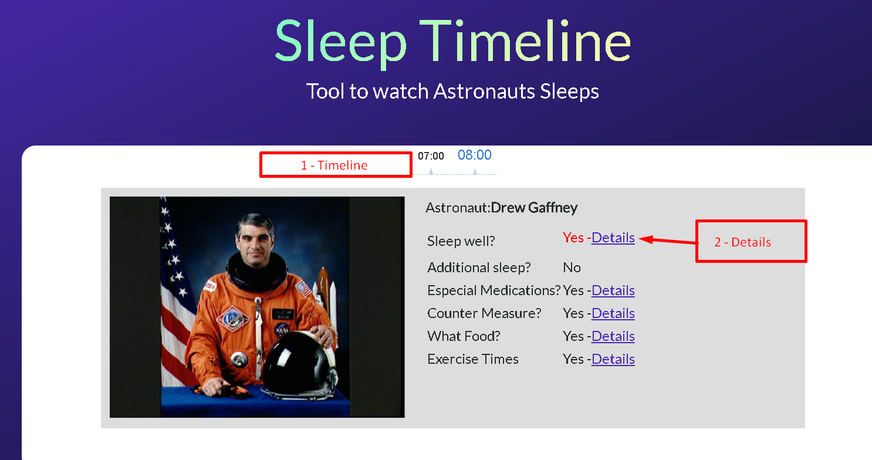
The Application
1 - Timeline of hours. When the user clicks on time, the system shows the astronaut who is sleeping at that moment.
2 - Details.By clicking on the details the system will show a modal with metadata about the selected astronaut.

Slide 6
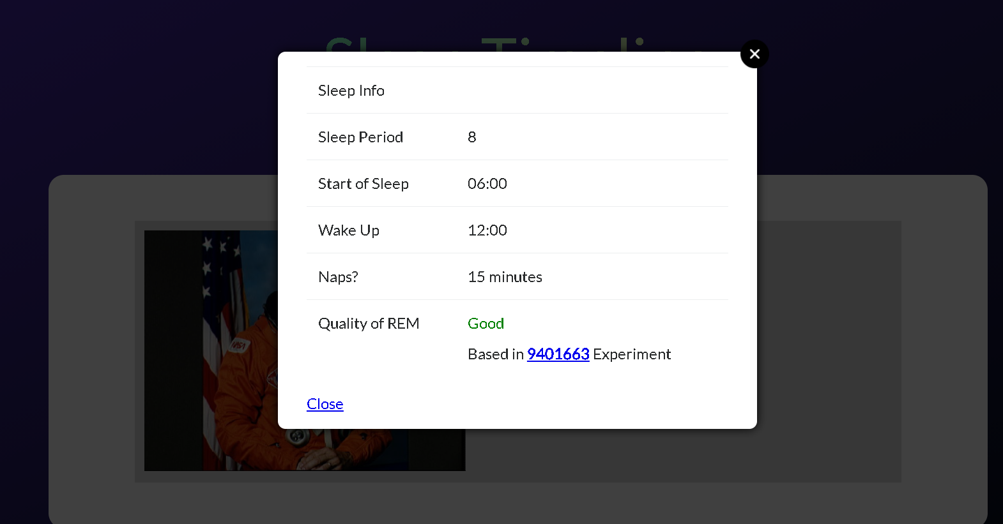
The Application
1 - Modal with details about the astronaut.

Slide 7

The Team
My name is Cézar. I’m software developer and i love build things.
Linkedin: https://www.linkedin.com/in/cezar-antonio-de-sousa/
Source of the project: https://github.com/cezarant/hackatoonNasa2020
Thank you by this challenge!

